Slide 1
INSURANCE CHARGE PREDICTION BY STATISTICAL METHODS
Presented by
SOURJYA SEN
B.Sc. (SEM - vi)
Department of statistics
Siksha Bhavana
VISVA BHARATI UNIVERSITY

Slide 2
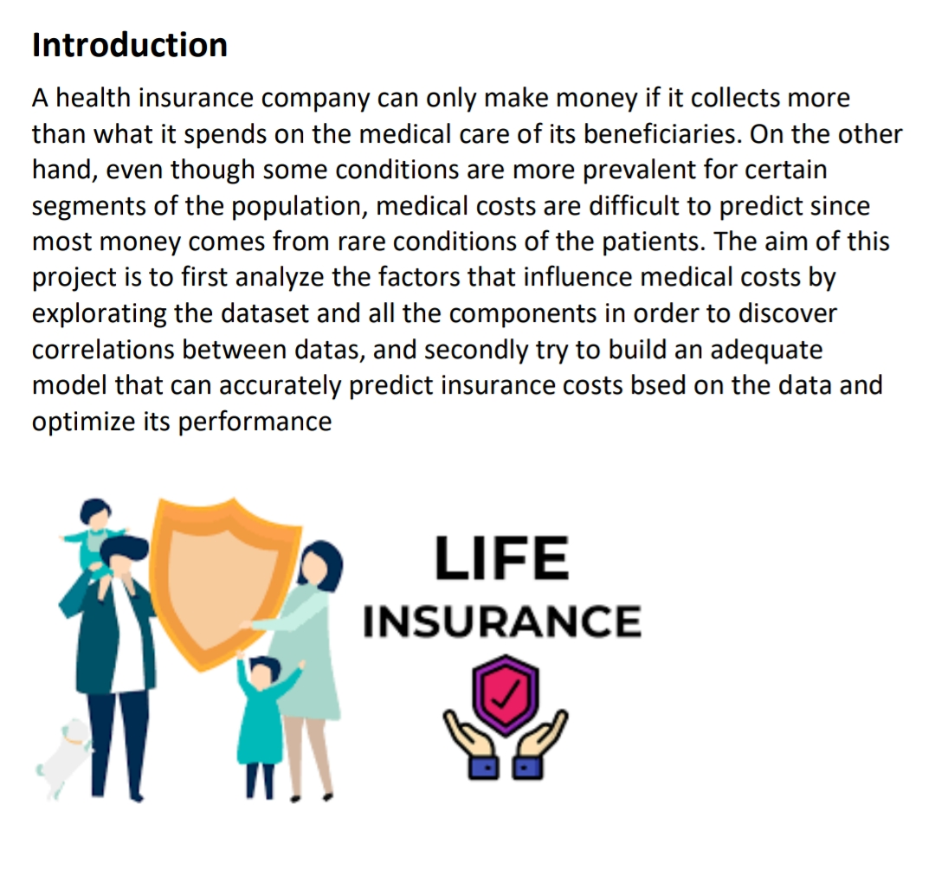

Slide 3
Aim of the project:
The aim of the project "Insurance Charge Prediction using Statistical Methods" is to develop a predictive model that accurately estimates insurance charges based on various factors such as age, BMI, smoking habits, and region. By leveraging statistical techniques, the project aims to analyze historical data, identify significant predictors, and create a reliable model that can assist insurance companies and individuals in understanding the factors influencing insurance charges. The ultimate goal is to provide valuable insights and actionable predictions that can support decision-making processes, risk assessment, and financial planning in the insurance industry.

Slide 4
Obtaining Data
This dataset is in public domain (available on https://github.com/stedy/Machine-Learning-with-R-datasets or https://www.kaggle.com/mirichoi0218/insurance), provided from "Machine Learning with R" by Brett Lantz, this is a clean dataset, as we will see in the next paragraph.
The cost of treatment depends on many factors: diagnosis, type of clinic, city of residence, age and so on. We have no data on the diagnosis of patients. But we have other information that can help us to make a conclusion about the health of patients and practice regression analysis. Nonetheless, it is good to have an understanding of what they are. Here are some factors collected by insurance, on which we will study the influence on the cost of medical insurance premiums: We have a dataset that includes 1338 observations on 7 variables

Slide 5
Variables description
AGE: age of primary beneficiary;
SEX: insurance contractor's gender (female or male);
BMI: body mass index which is expressed as the ratio between weight and square of an individual's height and is used as an indicator of the state of healthy weight (kg / m ^ 2). The ideal weight is excellent from 18.5 to 24.9;
CHILDREN: Number of children covered by health insurance;
SMOKER: Smoking/ Non-smoking
REGION: The beneficiary's residential area in the USA (northeast, southeast, southwest, northwest);
CHARGES: Individual medical costs billed by health insurance;

Slide 6
Exploratory data analysis
In this section we are going to explore the given dataset, trying to dig up some usefull information hidden between the variables, in order to build an effective model able to make predictions on the insurance charges. Moreover in some cases we will make use of some statistical tests to try explain the significance of some behaviours on the data, in particular:
F-test to check the homogenity of two population's variances.
T-test to verify possible significative differences between the means of two sets of data.
ANOVA Test, for the equality of two or more population's means
For all the cited tests we will take in consideration a significance level α=0.05

Slide 7
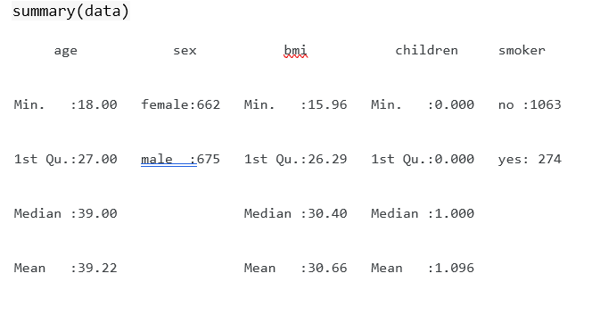
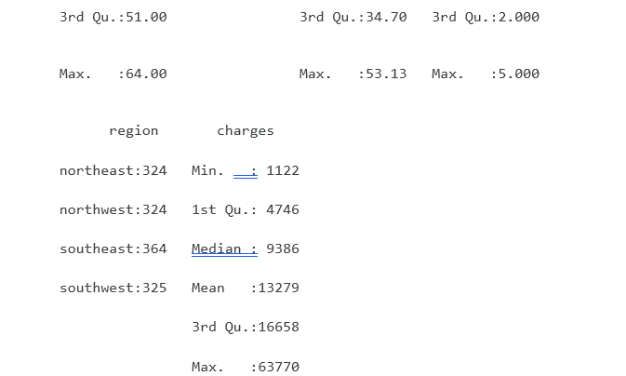
Descriptive statistic:

Slide 8
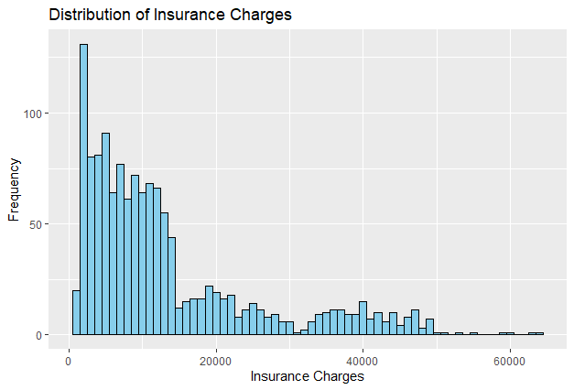
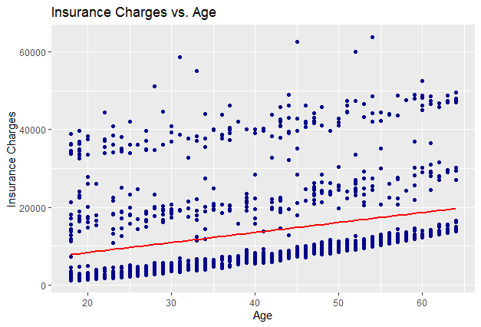
Interpretation of Distribution of Insurance Charges: The histogram shows that the distribution of insurance charges is positively skewed, with a majority of charges falling in the lower range. This suggests that most individuals have relatively lower insurance charges, while fewer instances have higher charges.
Interpretation of Relationship between Insurance Charges and Age:
The scatter plot and regression line indicate a positive relationship between age and insurance charges. As age increases, insurance charges tend to rise. This suggests that age is an important predictor of insurance charges, with older individuals generally facing higher charges.

Slide 9
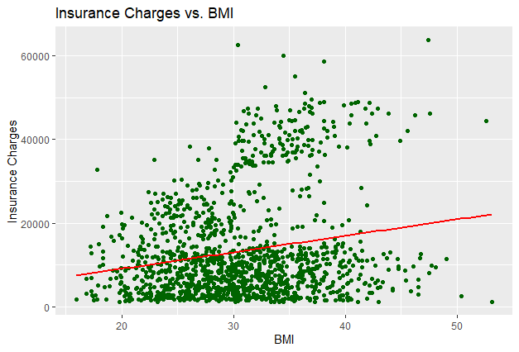
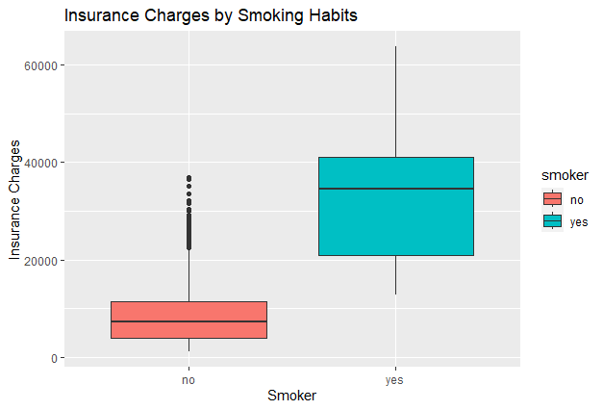
Interpretation of Relationship between Insurance Charges and BMI: The scatter plot and regression line show a positive association between BMI (Body Mass Index) and insurance charges. Higher BMI values are generally associated with higher insurance charges. This suggests that BMI is a relevant predictor of insurance charges, with individuals having higher BMI facing higher costs.
Interpretation of Relationship between Insurance Charges and Smoking Habits:
The boxplot demonstrates that smokers tend to have higher insurance charges compared to non-smokers. This indicates that smoking habits can significantly impact insurance charges, with smokers facing higher costs than non-smokers.

Slide 10
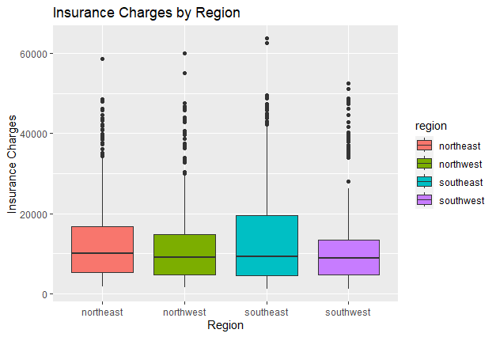
Interpretation of Relationship between Insurance Charges and Region:
The boxplots for different regions reveal variations in insurance charges. This suggests that the region of residence can be an influential factor in determining insurance charges. Certain regions may have higher average charges compared to others.

Slide 11
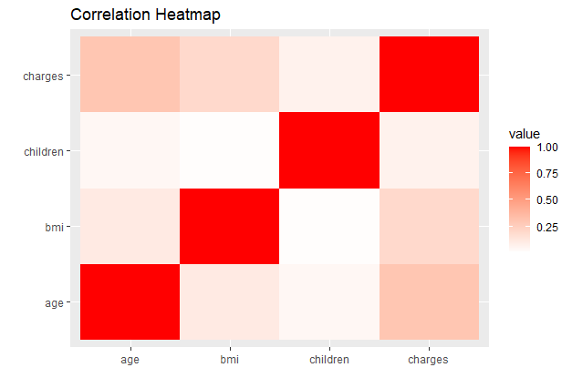
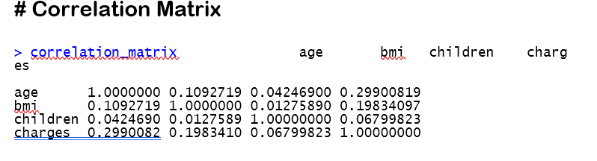
CORRELATION HEATMAP
Interpretation of Correlation Matrix and Heatmap:
The correlation matrix shows the pairwise correlation coefficients between age, BMI, number of children, and insurance charges. The strongest positive correlation is observed between age and charges, indicating that age has a significant impact on insurance charges. BMI also exhibits a positive correlation with charges, although somewhat weaker. The number of children appears to have a relatively weaker correlation with charges.

Slide 12
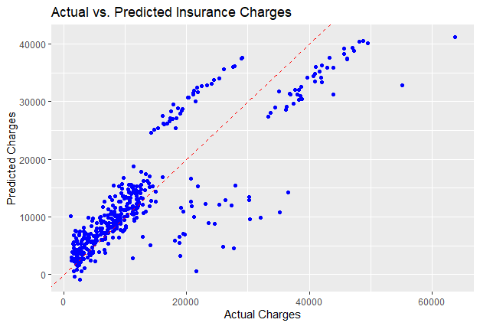
Interpretation:
The linear regression model provides insights into the relationship between insurance charges and the predictor variables (age, BMI, smoker, region). The summary of the model helps understand the significance and impact of each variable on insurance costs.
The RMSE value indicates the average difference between the actual charges and the predicted charges. A lower RMSE indicates better predictive accuracy.
The scatter plot of actual vs. predicted values provides a visual representation of how well the model predicts insurance charges. Ideally, the points should align closely with the dashed red line, indicating a strong correlation between the actual and predicted charges.

Slide 13
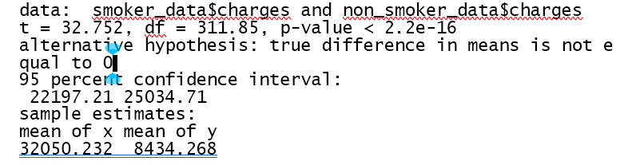
Interpretation: The t-test suggests that there are significant differences in insurance charges between smokers and non-smokers. The mean insurance charges for these two groups are significantly different, indicating that smoking behavior has a significant impact on insurance costs.

Slide 14
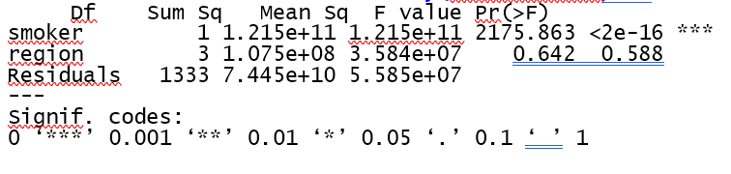
Interpretation: The ANOVA test allows us to determine whether there are significant differences in means among the groups defined by the predictors (smoker and region). The p-value obtained from the ANOVA test indicates the significance of the observed differences.
If the p-value is less than the chosen significance level (e.g., 0.05), it suggests that there are significant differences in means among the groups. On the other hand, if the p-value is greater than the significance level, it indicates that there is insufficient evidence to conclude significant differences in means.
Remember to consider the specific context of your insurance prediction data and any relevant assumptions associated with the ANOVA test.

Slide 15
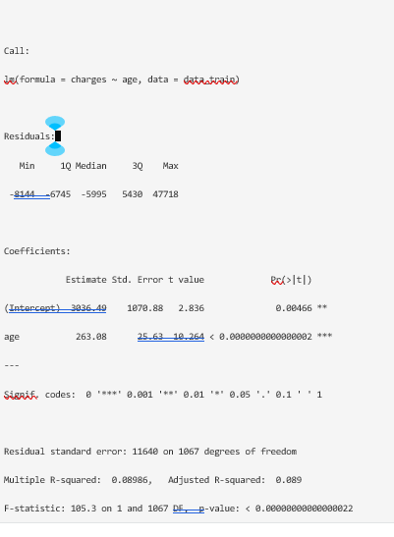
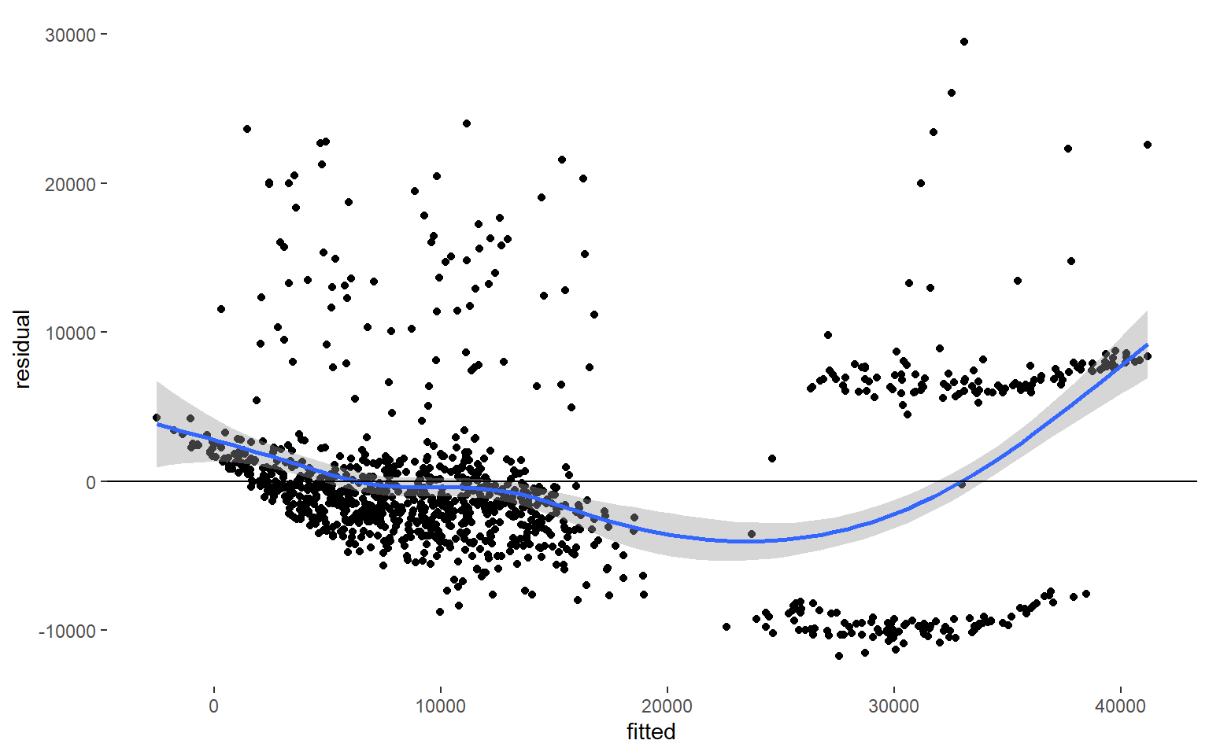
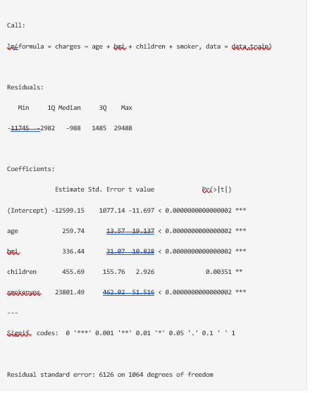
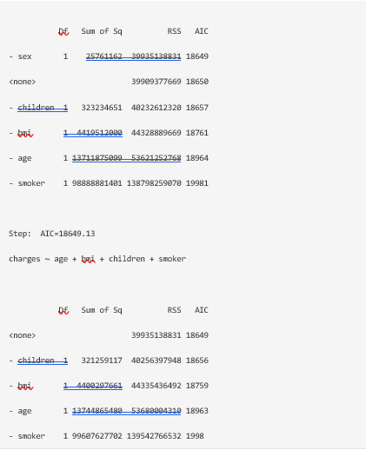

From the plot residuals become more negative as the fitted values increase, the plot pattern indicate that our model is not quite linear.

Slide 16
Conclusion:
Herewith the comparison between model_2 using linear regression and model_poly which we improve using polynomial regression technique
Algorithm | Model | R-squared | RMSE
Linear Regression | model_2 | 0.7475 | 5844.718
Polynomial Regression | model_poly | 0.8413 | 4667.661
We can conclude after processing the model, feature engineering plays an important role to improve the model. In this case we apply by making polynomial combinations of features with degree 2. We can see that the model improves significantly, with R-squared : 0.8413, higher than model_2 and RMSE : 4667.661, lower than model_2. However, some assumption of Linear Regression is not satisfying , like the normality of Residuals still not distributed normally, and multicollinearity found in Polynomial Regression model, but in this case of multicollinearity is makes sense since some features in polynomial regression were created by multiplying two features from linear regression model. Sometimes in business, assumptions is not really matter, but it’s good to use assumptions, to make our model better to use.
The models we have built can be used for inference of how the different predictors influence the outcome but it is far from perfect. But some feature engineering such as polynomial regression plays an important role to improve the model. There is still presence of non-linearity and non-constant variance of errors. Moreover, the outliers points should be analyzed to find a better model. To obtain even more precision in its predictions, this insurance company should collect more data about its customers in order to explain the behavior of some individuals that we have noticed in the exploratory phase.
We can be sure that smoking could affect your wallet.

Slide 17
REFERENCE
Data Source: https://www.kaggle.com/code/cracc97/insurance-charge-accurate-eda-regression/input ,
https://rpubs.com/tangerine/medical-cost,
https://rpubs.com/racha/insurance
Books:
The Fundamentals of Statistics (Vol-I and Vol-II) – A.M. Goon, M.K. Gupta and B Dasgupta
• The Fundamentals of Applied Statistics – Gupta and Kapoor

Slide 18


